Slide 1

Level: Advanced – session 6
Game Development with Unity
Omid Saadat

Slide 2
How to make your 3D game look
AWESOME

Slide 3
Lights in general
Light Types:
  Spot
  Directional
  Point
  Area
This will look too normal

Slide 4
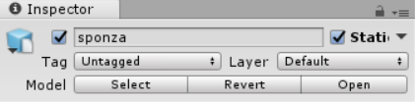
How to look awesome?
Check Lighting window. (next slide)
Mark your static objects as Static!
Tweak Light setting.
  Baking
  Shadow type
  Shadow resolution
Emissive materials: check object setting for baking
Reflection and reflection probes

Slide 5
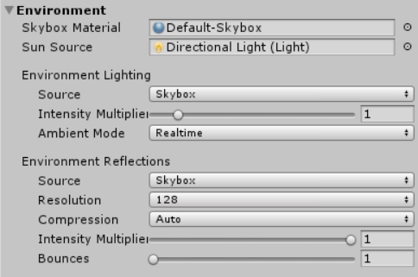
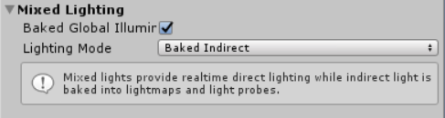
Lighting window
Do these steps on a strong
Hardware
Environment:
  Ambient mode
  Do we need Reflection?
Realtime GI
  What is GI?
  Baked or Realtime? When?
Mixed Lighting

Slide 6
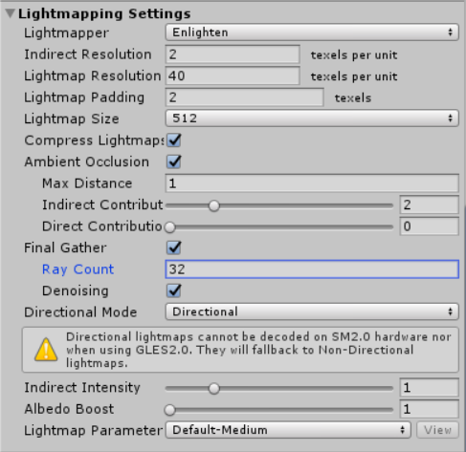
Lighting window
Lightmapping Setting:
  Lightmapper
    Progressive
    Enlighten
  LightmapSize
  Resolution
  Ambient Occlusion
  Final Gather: low for test
  Fog!

Slide 7
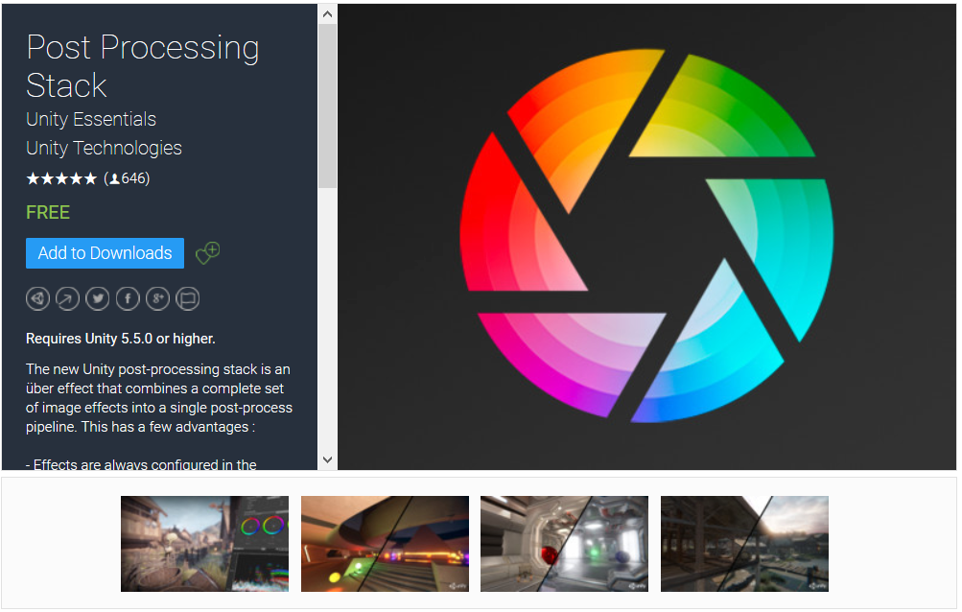
Camera and PostProcessing
Camera
  Differed rendering path
  Disable MSAA
Get the latest version of PostProcessing Stackfrom Unity Asset store

Slide 8
Post processing
Bloom
Antialiasing
Vignette
Chromatic aberration
Color Grading
Grain
Motion blur
...

